Slide 1

CISC320 Algorithms
Algorithm Flowchart
Austin Cory Bart AlgoTutorBot University of Delaware
Notes:
ATB: Let’s learn about Algorithm Flowcharts.

Slide 2
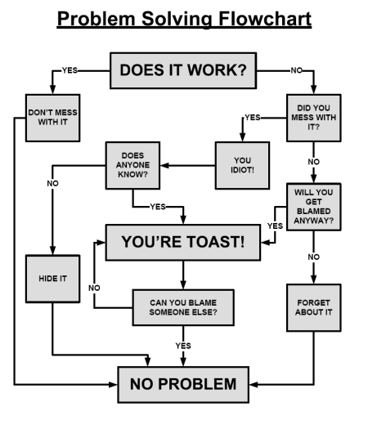


An Algorithm for Algorithms
Notes:
Bart: You have been writing algorithms for many years now, and it is time that we started thinking about the process of writing algorithms.
Bart: Our goal today is to make an algorithm for making algorithms.
Bart: The end product will probably be some kind of flowchart, like the one here. Bart: Of course, there are many other ways to express algorithms, and we actually don’t mind what you come up with.
ATB: I disagree, if it’s not a flowchart, then your answer will be deleted and you will fail the course.
Bart: ATB, we talked about this. You have to stop threatening to fail the students.
ATB: Fear is the only way to motivate learning.
Bart: Not true, and we’re going to talk about that later. For now, though I want to focus on building up algorithmic flowcharts.

Slide 3

A Question
How do you solve problems?
Notes:
Bart: Here’s a question for you, how do you solve problems? I want you to take a minute to reflect on that. [Wait]
ATB: I know how I solve problems. I threaten to fail them until they improve.
Bart: Don’t refer to the students as problems, AlgoTutorBot. That’s really rude.

Slide 4
The “IDEAL” Way
I
Identify the problem
D
Define the context
E
Explore possible strategies
A
Act on the best solution
L
Look back and learn
Notes:
Bart: One way to approach problems is the IDEAL way.
Bart: First, you identify the problem and understand it as fully as you can.
Bart: Next, you look at the context of the problem. Looking at the goal and surrounding environment of the problem can help you refine your understanding of the problem.
Bart: Then, you need to explore possible strategies. Hypothesize and experiment, and do research as necessary.
Bart: At some point, you then need to commit to an answer and see how it goes.
Bart: When you are done, you should look back and see what you can learn from the experience.
Bart: This is just one example of a general problem-solving strategy. It’s very vague and high-level.
Bart: But when we are solving algorithmic problems, you should also be able to be more specific.

Slide 5
Two-Attempt Approach
Solo Attempt
Take a Break
Attempt Again
Reflect
Use paper-and-pencil
No internet, no friends, no textbook
Spend ~30 minutes
Have a quiet space
Reflect
Take some quick notes on what you tried
Write down anything you learned
At least 4 hours
Ideally overnight
Distract your brain
Maybe take a nap.
This time use all your resources
Google
Textbook
Instructor
Record where you got help
Work until done
Write at least a short paragraph
What did you learn?
What did you try?
What worked?
What failed?
Notes:
Bart: I want to offer a general approach to tackling tough algorithmic problems and maximizing your learning.
Bart: You are going to be required to make your flowchart work within this basic flow, at least during this course.
Bart: I know that’s a little demanding, but I think this has some very real advantages.
Bart: Remember, the major goal here isn’t to solve the problem, it’s to maximize what you learn from it.
Bart: The core premise is that you will have two major attempts at the problem.
Bart: On the first attempt, you sit down by yourself without the textbook, or the internet, or anything else.
Bart: Find a quiet room and spend 30 minutes tackling the problem on paper and pencil.
Bart: You might finish it, or you might not. Either way is okay.
Bart: After 30 minutes, take a few minutes to write down what you tried, what you learned, and what you are thinking about next.
Bart: Then, put the whole thing down and take a break.
Bart: Seriously, at least 4 hours, ideally more. Take a nap, play some games, read a book, eat something.
Bart: Getting some sleep is really the best thing to do here before your next attempt.
Bart: When you are ready, try the problem again.
Bart: But this time, you can use all your resources and strategies.
Bart: This includes Google, the textbook, the instructor, your classmates. Anything that might help.
Bart: If you google for anything, record the URLs.
Bart: If you got help from a human, record what you asked and describe what they said.
Bart: Keep at the problem until you solve it.
Bart: At the end of the work session, write a short paragraph summarizing the attempt.
Bart: Be sure to identify what you tried that worked, that failed, and what you learned.

Slide 6
Specific Strategies
The previous approach is a general strategy
I expect to see more than just that in your flowchart.
Consider previous problems you tackled; how did you do so?
Think about strategies for both kinds of attempt (solo and with resources)
What parts of the problem did you look at?
What tactics and algorithms and data structures do you have?
Self-reflect!
Doesn’t have to be perfect, but by the time we are done it will be EXTENSIVE.
Notes:
Bart: The process I just described is a required starting point, but I expect your final flowchart to be way more extensive.
Bart: We’re going to work on these repeatedly over the course of the semester, so it’s okay if it’s not perfect yet.
Bart: But the more detail now the less you have to give me later.
Bart: The key is to start identifying little strategies you have when tackling these problems.
Bart: Be sure to recognize when it is a strategy involving a resource and when it is not.
Bart: What parts of the problem do you look for? What knowledge have we taught you that is relevant? What tactics can you use?
Bart: A lot of this may be IF statements, like, “If the question asks for a linear time algorithm, it might involve traversing a list.”

Slide 7
Today’s Activity
Make your Algorithmic Flowchart
Apply to a problem
Hand in your solution to the problem AND your flowchart
We will ask you to iterate on the flowchart repeatedly over the semester!
Notes:
Bart: The goal today is to have you create the flowchart, and then use it on a problem.
Bart: When you are done, you’ll hand in both your solution to the problem and this first version of your flowchart.
Bart: As I said before, you’ll iterate on that flowchart repeatedly over the semester, so don’t lose its source.
Bart: Good luck, and think critically!

